Slide 1
Advanced Testing Techniques
Tips from the trenches
Rob Moore
Principal Consultant, Readify
@robdmoore

Slide 2
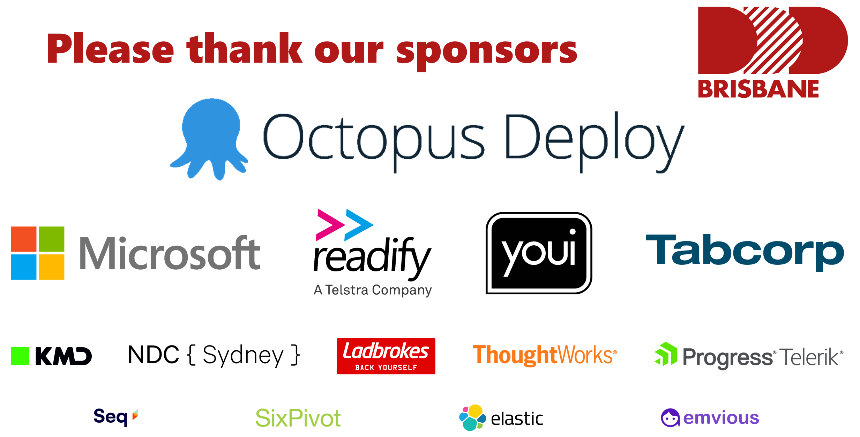

Slide 4
The conversation…

Slide 5
Unit tests are awesome!
// Arrange
MockIceCreamPriceCalculator.Calculate("ChocTop").Returns(5.75);
MockCustomerProvider.FindByName("Graeme").Returns(new [] {MockCustomer});
var initialBalance = MockCustomer.Balance;
var iceCreamVanUnderTest = new IceCreamVan(MockIceCreamPriceCalculator, MockCustomerProvider);
// Act
iceCreamVanUnderTest.Sell("Graeme", "ChocTop");
// Assert
MockCustomer.IceCreams.Received().Add(Arg.Any<Icecream>(i => i.type == "ChocTop" ));
MockCustomer.Balance.ShouldBe(initialBalance – 5.75);

Slide 6
Testing behaviour > implementation
Time to implement feature: 20 mins
Time to write new tests: 30 mins
Time to fix broken tests: 4 hours
Confidence of no regression: Medium
Likelihood of hacking feature: High
Fear of refactoring: High
Notes:
Did you see… We were testing implementation. Not behaviour
Change the implementation
Tests Failing 1200
New feature – 5 minutes
Time spent fixing tests – 2 days
Fear of refactoring: 80%
Likelihood of changing feature to ‘work around’ this: 70%
Real example to illustrate

Slide 7
What does testing behaviour look like?
// Arrange
const decimal initialBalance = 10;
var chopTop = Save(ObjectMother.IceCreams.ChopTop.Build());
var graeme = Save(ObjectMother.Customers.Graeme.WithBalance(initialBalance).Build());
// Act
Resolve<IceCreamVan>().Sell(graeme.Name, chopTop.Name);
// Assert
graeme.IceCreams.ShouldContain(chocTop);
graeme.Balance.ShouldEqual(initialBalance – chocTop.Price);
Notes:
Did you see… We were testing implementation. Not behaviour
Change the implementation
Tests Failing 1200
New feature – 5 minutes
Time spent fixing tests – 2 days
Fear of refactoring: 80%
Likelihood of changing feature to ‘work around’ this: 70%
Real example to illustrate

Slide 8
#tdd4lyfe
Notes:
Unit == class right – I’m not doing TDD unless I mock out all the collaborators.
What you're talking about are integration tests, man.
Integration tests are evil. Some dude said that!

Slide 9
Unit != class
"A test-case per class approach fails to capture the ethos for TDD. Adding a new class is not the trigger for writing tests. The trigger is implementing a requirement."
Ian Cooper - "TDD, Where did it all go wrong?"
Notes:
Kent beck said unit tests test individual units (modules, functions, classes) in isolation
Ian Cooper (TDD, where did it all go wrong) said the same thing
Rob and Matt burned a pyramid or something about this.

Slide 10
#UItests4lyfe?

Slide 11
UI tests are hard, time consuming and brittle
Time to implement feature: 20 mins
Time to write new tests: 2 hours
Time to maintain tests: Days
Intermittent false negatives: Daily
Feedback cycle: Hours
Notes:
24 hour test runs
Intermittent false negatives
Not always integrated into the pipeline. Forgotten about. Left to rot!
Graeme’s story about clock VM reset
An afterthought written solely by 'Testers'

Slide 12
Oh!? So we should avoid UI tests?
Notes:
Not for regression testing, use them for increased confidence for the really important parts of the system.

Slide 13
Advanced Testing Techniques
Tips from the trenches
Rob Moore
Principal Consultant, Readify
@robdmoore

Slide 14
Testing behaviour over implementation
Recap
Behaviour is more useful to test than implementation detail and less brittle to refactor
Unit tests and TDD != testing a single class
Integration tests != testing multiple classes
UI testing is useful, but fragile, and should be used judiciously
Notes:
Segue in recap of convo

Slide 15
techniques
What techniques can we use to test behaviour?

Slide 16
Subcutaneous Tests
UI
Top-level component / MVC Controller / MVVM View etc.
Subcutaneous Test
Domain / Services / Repositories / Sub-components etc.
System-owned Database(s)
External System(s)
https://bit.ly/subc-code-examples

Slide 17

Shifting gears mindset
Notes:
Gears approach (Ian C) – it’s OK to throw out tests

Slide 18

Liberated Red / Green / Refactor
Notes:
Write the worst code you can to make it pass. Then refactor... But refactoring should not change the test.

Slide 19

Object Mother and Test Data Builder and derived values and anonymous values and equivalence classes oh my?!
https://bit.ly/testdatatalk

Slide 20
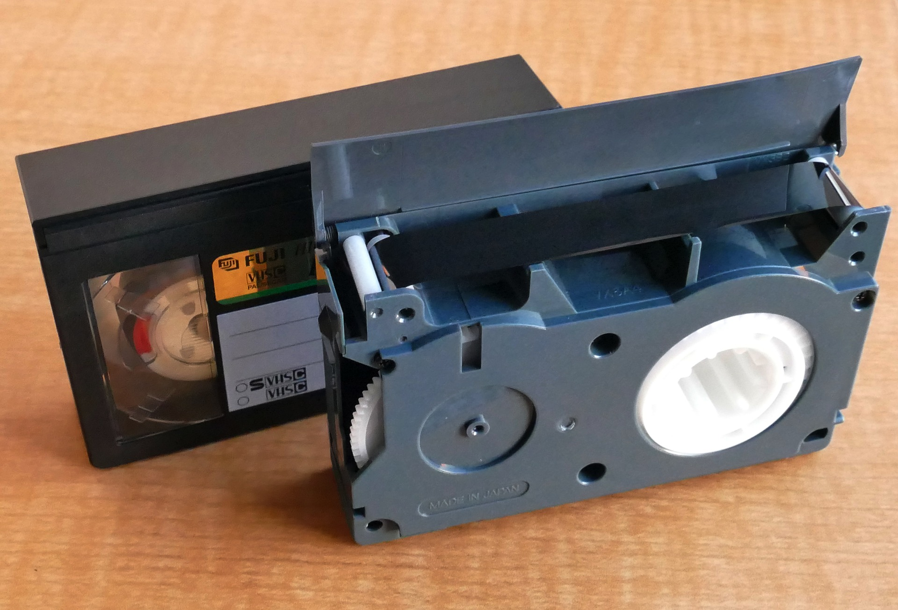
VCR Pattern
Tool examples: github.com/vcr/vcr (Ruby, but has list of ports to other languages)
Your code
External Dependency
Http Client
VCR
Response mock (filesystem)

Slide 21
Approval / Snapshot Tests
Tool examples: Approvaltests.com, Jest (snapshot testing), Shouldly (ShouldMatchApproved)

Slide 22
public class NBNVoipAndInternationalCallsCheckoutScenario : SubcutaneousTest<CheckoutController>
{
public void GivenUserHasAddedNBNVoipAndInternationalCallsBonusOptionsToTheirCart()
{
var session = ObjectMother.Sessions.Default;
session.AddToCart(ObjectMother.Products.NBN);
session.AddToCart(ObjectMother.Products.Voip);
session.AddToCart(ObjectMother.Products.InternationalCallsBonusOption);
SeedContext.Save(session);
}
public void WhenTheUserChecksOutTheirCart()
{
ExecuteControllerAction(c => c.Index(Builder<CheckoutViewModel>.Build()))
}
public void ThenSendRequestToTheProvisioningSystem()
{
var request = Resolve<MockProvisioningSystem>().Requests.Single();
request.ShouldMatchApproved();
}
}

Slide 23
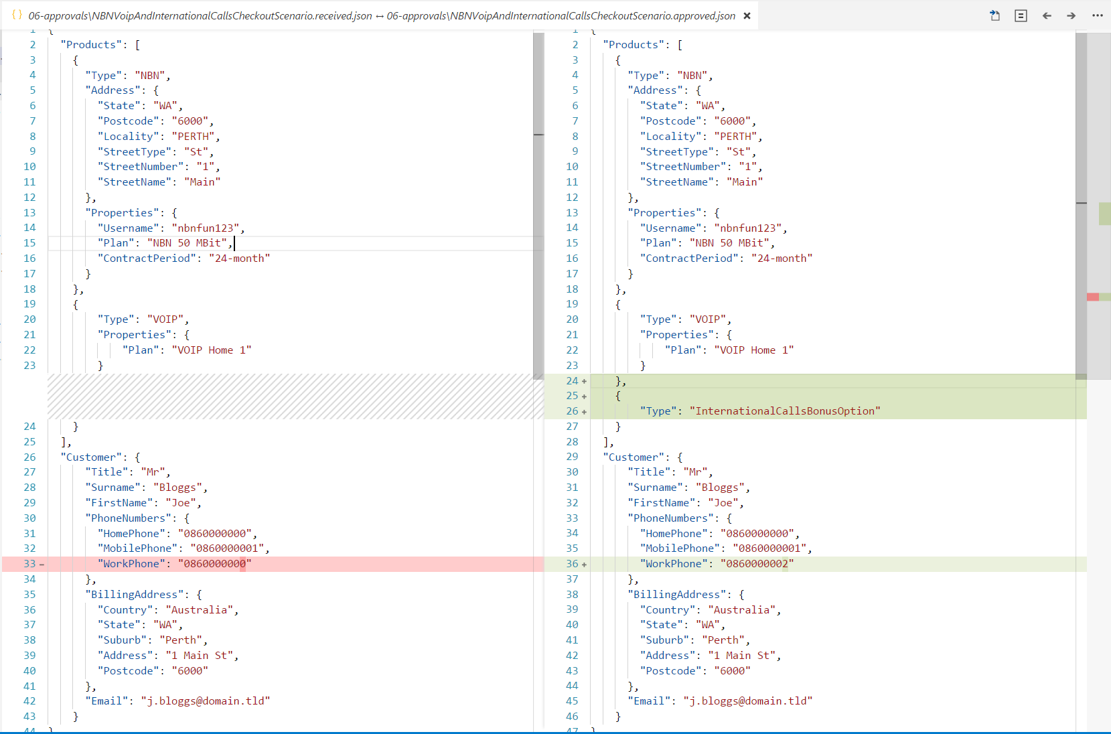

Slide 24
Pragmatic testing
Cool, we can now test behaviour, but how do we determine what/when to test?

Slide 25
Asking why we test…
“The ultimate goal here is to ship code it’s not to write tests; tests are just a means to the end of shipping code.” “I can have 100% code coverage and have noone use my product and I can have 0% code coverage and it’s a huge success; there is no correlation between the two things.”
Jimmy Bogard - “Holistic Testing"
Notes:
Tangential to behaviour testing
Start to examine the circumstances under which we decide when and what to testS

Slide 26
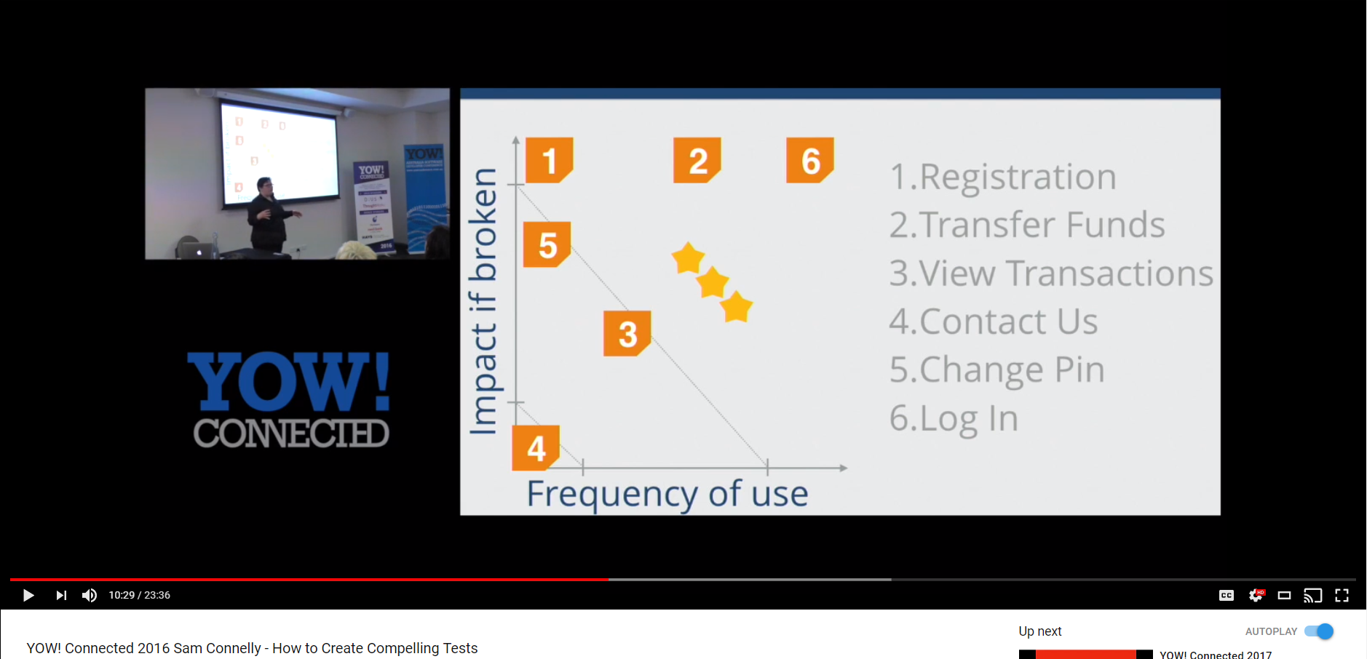
Testing based on impact

Slide 27

Speed vs confidence
?

Slide 28
Speed
implementation tests
real database calls
Automated UI testing
Manual testing
Confidence
Notes:
Metroplex example for tests

Slide 29
Testing based on speed vs confidence
Minimum confidence level to deploy feature to prod is a key driver for release.
Challenge yourself to set a minimum confidence level that is as low as possible
Create a testing strategy that meets that confidence level as fast as possible
Adjust the testing strategy over time based on observations (inspect and adapt)
Business Decision
Technical Decision
Both
Notes:
BDDfy example with product owner

Slide 30
Key question…
How do you measure confidence level?
Notes:
Nomenclature for describing risk coupled with “test framework”
Not just about testing anymore – impacts design, analysis, etc.

Slide 31
Risk-based Testing
Introduce a risk-based model to classify your features and create a common nomenclature between business and technical stakeholders.
Track the risk rating per story in your task-tracking system.
Create a clear way to determine a rating.
Notes:
Talk about how you then match the testing against the risk e.g. UI testing for critical, only manual exploratory testing for trivial etc.

Slide 32
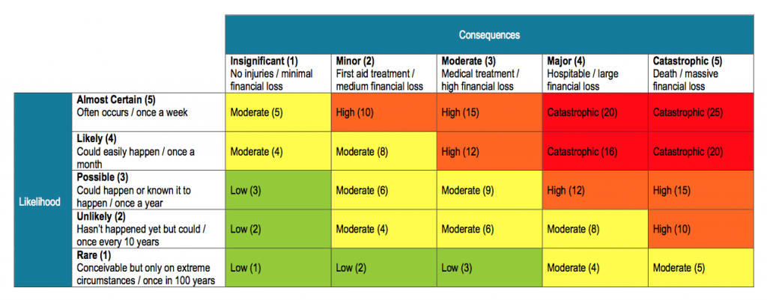
Organisational risk matrix
https://safeworkpro.safeworkpro.com/risk-assessment/an-example-of-risk-assessment-matrix
Notes:
Talk about how you then match the testing against the risk e.g. UI testing for critical, only manual exploratory testing for trivial etc.

Slide 33
Risk-based Testing strategy
 | Manual | Unit | UI
Trivial | No | No | No
Low | Once only | No | No
Medium | Once only | Basic coverage | No
High | Once only | Combinatorial coverage | Happy path
Critical | Every release | Combinatorial coverage | Happy and sad path
Notes:
Talk about how you then match the testing against the risk e.g. UI testing for critical, only manual exploratory testing for trivial etc.

Slide 34
What happens after we deploy?
Pragmatic and risk-based testing of behaviour during development is all well and good, but it’s just the beginning!

Slide 35

Shift left vs shift right…
As systems get more complex unpredictability rises and shift left has diminishing returns after a point.
Notes:
Left vs right - cost of finding a bug early vs unpredictability of prod / likelihood of finding in complex env
Speed of teams – separate deploy from release
If we can separate deploy and release we can speed teams up by having different confidence levels <- applying pragmatic thinking to this testing
Efficient shift left and with extra time that’s freed up we can shift right
https://www.pexels.com/photo/arrow-communication-direction-display-235975/

Slide 36
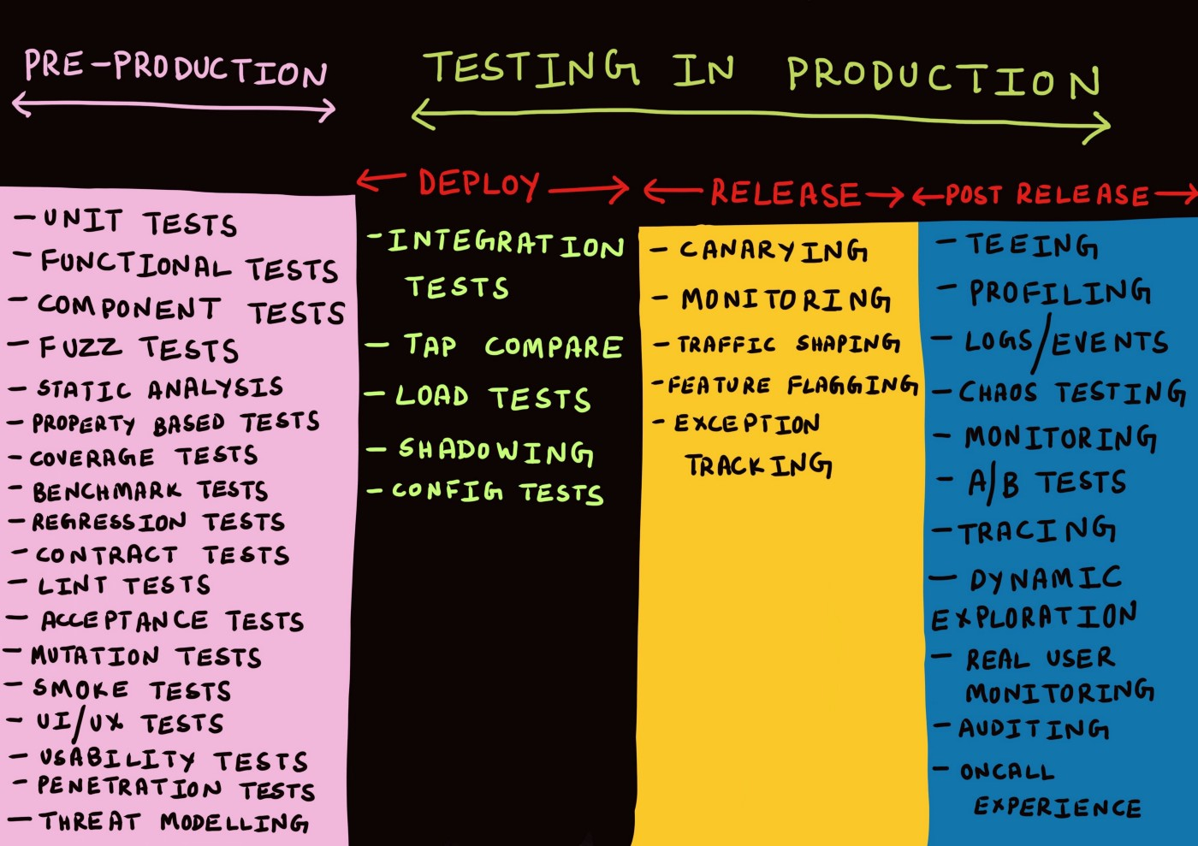
Image from “Testing in Production, the safe way” by Cindy Sridharan
https://medium.com/@copyconstruct/testing-in-production-the-safe-way-18ca102d0ef1
Also:
Behaviour Driven Infrastructure (BDI)
Observability
Magic number testing
Synthetic transactions
Notes:
Not a go or no go
Speed up teams by allowing continuous releasing and provide testing techniques to provide ongoing confidence as you flow changes through deploy, release and post-release
Benefits:
Limit blast radius around systems
Move from are we confident to deploy it to are we happy to release it
Complex environments – can’t replicate problems until we get to prod
Shift left on testing is cheaper, but we’re also less likely to find an error (complex systems, emergent behaviour) so we need to focus on efficient testing and confidence end to end
80% issues, 20% effort on the left
Remaining effort: build resilience into systems
Testing on the left is answering a specific question, stuff to the right is more dynamic.
Monitoring answers a specific question, observability is a characteristic of the system that allows us ask arbitrary questions about what’s happening in the system at any point in time so we can more quickly diagnose problems.

Slide 37
recap

Slide 38
recap
Behaviour > implementation
Techniques for the toolbelt
Pragmatic testing
Risk-based testing
Shift-left vs right
Testing in production

Slide 39
Advanced Testing Techniques https://github.com/robdmoore/AdvancedTestingTechniquesPresentation
Thanks! Questions?
Rob Moore
Principal Consultant, Readify
@robdmoore

Slide 40
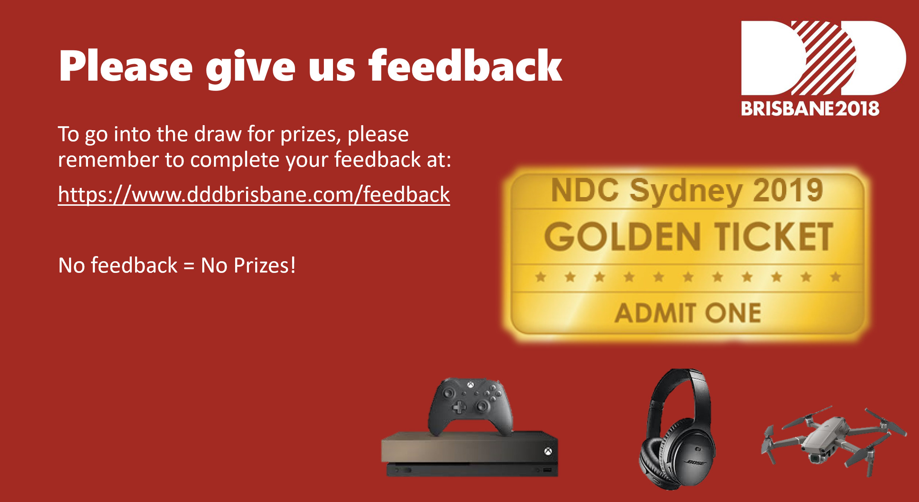

Slide 41
What about after we deploy to prod?
Behaviour Driven Infrastructure (BDI)
Testing logs
Blue / Green or canary deployments
Testing In Production (TIP; #yolo :P)
Run tests against production environments
Observability over monitoring
Magic number testing & synthetic transactions
Notes:
Introduce by saying 'Now the software has shipped you might think that we've finished with testing... '
BDI – Graeme
Testing Logs – Graeme
Blue / Green – Graeme
TIP - A/B testing, feature toggling by beta users - Graeme
Observability over monitoring – complex systems may always have components that are down. Could create noise. Need to use techniques like structured logging to make it easier to observe systems in real-time, and prove that the system is functioning.

Slide 42

Final thought – static → dynamic
Notes:
Love. Your. Work :)

Slide 43
Thanks! Questions?

Slide 44
Testing behaviour > implementation
// Arrange
const decimal initialBalance = 10;
SeedContext.Save(ObjectMother.Customers.Graeme.WithBalance(initialBalance));
SeedContext.Save(ObjectMother.IceCreams.ChocTop.PricedAt(5).Build());
// Act
Resolve<IceCreamVan>().Sell("Graeme", "ChocTop");
// Assert
var graeme = VerifyContext.Customers.Single();
graeme.IceCreams.ShouldContain("ChocTop");
graeme.Balance.ShouldEqual(initialBalance - 5);
Notes:
Did you see… We were testing implementation. Not behaviour
Change the implementation
Tests Failing 1200
New feature – 5 minutes
Time spent fixing tests – 2 days
Fear of refactoring: 80%
Likelihood of changing feature to ‘work around’ this: 70%
Real example to illustrate

